Slide 1
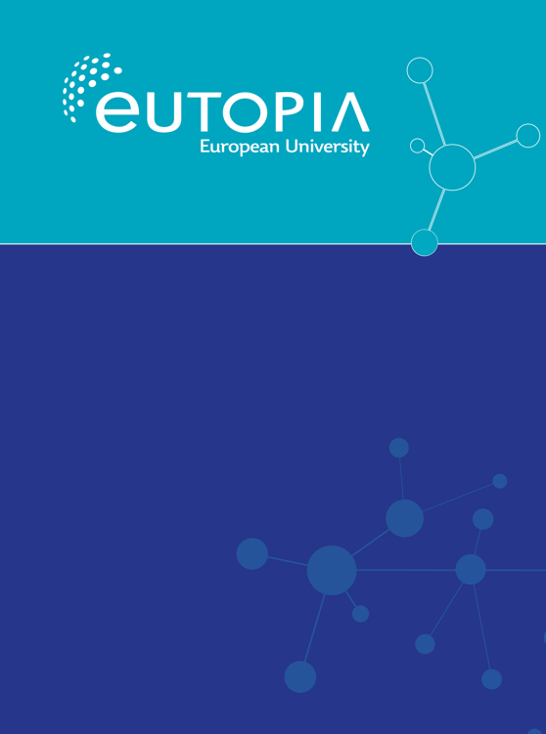
CRC Incubators
Online webinar
30.08.2022

Slide 2
AGENDA
Updates about CRC Incubators & Implementation guidelines
Final report
Q&A

Slide 3
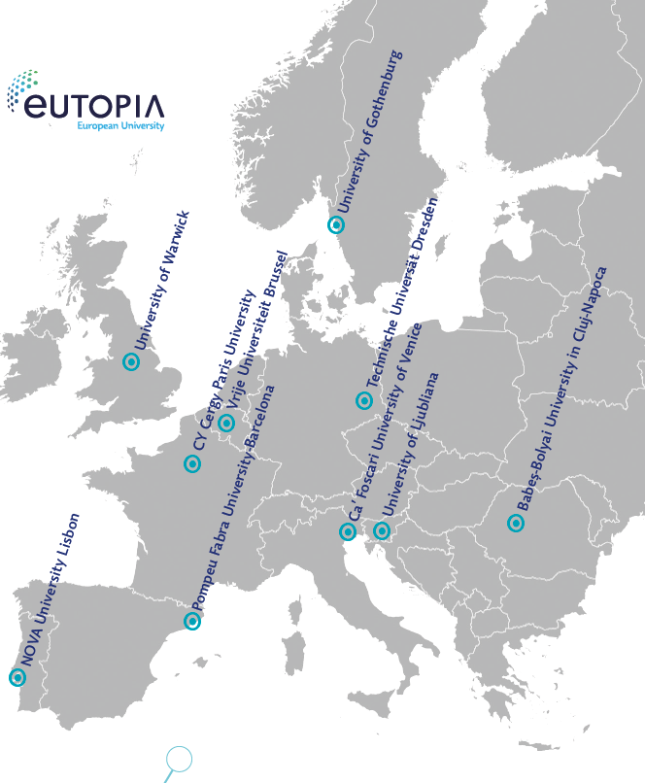

EUTOPIA FOUNDING MEMBERS
6 universities formed the EUTOPIA 2050 project awarded in 2019 by the European Commission for their ambition and vision to build a European University

Slide 4
Updates about CRC Incubators & Implementation guidelines

Slide 5
CRC Incubators
Results of the evaluation
17 approved CRCs Incubators
78 budgeted researchers

Slide 6
CRC Incubators
Budget
Payment of the budget will be done through own universities according to local regulations
Each CRC researcher from a EUTOPIA founding member university receives up to 3000 Euro for networking purposes (travel, accommodation, subsistence etc)
Budgeted researchers from VUB, CY, GU, UPF and Warwick received an additional 2000 Euro/researcher to be spent on networking costs or on other expenses (e.g. research expenses or on external partners)

Slide 7
CRC Incubators – use of budget
Budget | Budget track | Eligible participants | Eligible countries | Eligible costs
€3000 | EU co-finance through the 2050-project | Only budgeted CRC Incubator partners from the 6 EUTOPIA universities | Costs incurred only for activities organized in the countries of one of the 6 EUTOPIA universities | Costs incurred for networking purposes such as travel, living accommodation and subsistence.
€2000 | University co-finance through the 2050-project | Internal & external stakeholders, including participants from the 4 EUTOPIA universities and beyond | Internal & external stakeholders, including participants from the 4 EUTOPIA universities and beyond | Costs for networking purposes (internal & external stakeholders), research expenses etc. Subject to the procedure of each of the 6 EUTOPIA universities.

Slide 8
Final report

Slide 9
Reporting and evaluation
Budget reporting – check with own institution
Final report form must be submitted latest 30 November 2022
Monitoring and evaluation May-June 2023
What to save/prepare/document for the final report?
Participants lists, print screens
Links to webpages
Bills

Slide 10
Questions from the final reporting template
Details of the CRC Incubator
Final membership and any changes in the membership of the CRC Incubator (include name, gender and hosting institution for each person). Budgeted and unbudgeted members.
Aims and activities
Planned activities (online & residential)
Changes in the planned activities (ex added or removed activities, change of objectives etc)
The SDG your CRC incubator works towards
External stakeholders
External stakeholders
Online and/or residential activities where there was a public? Description & no of participants

Slide 11
Results and impact
Documenting results as: experiments, other research, publications, submitted and/or granted joint applications
High risk – high return project
Description of results & description of impact
Description of cross-sectorial collaboration
Future plans for your CRC Incubator
Dissemination and visibility
Links
Participants lists

Slide 12
QUESTIONS & ANSWERS

Slide 13
CONNECTED RESEARCH COMMUNITIES
Vrije Universiteit Brussel: RD.secretariaat@vub.be
CY Cergy Paris University: Karine Gambier-Leroy, Secretary-General of the Institut for Advanced Studies, CY Cergy Paris University, karine.gambier-leroy@cyu.fr
University of Gothenburg: Andreea Maris, Grants and Innovation Office, University of Gothenburg, andreea.maris@gu.se
University of Ljubljana: Rebeka Lesjak, University of Ljubljana Office for Research, rebeka.lesjak@uni-.lj.si
Pompeu Fabra University: Mireia Calm, EUTOPIA Office, eutopia@upf.edu
University of Warwick: warwickineurope@warwick.ac.uk

